Slide 1
ORLJ 4009-Session 2.0
Understanding Behavioral Research
Madhabi Chatterji, Ph.D.
Professor of Measurement, Evaluation and Education
Director, Assessment and Evaluation Research Initiative (AERI)
Teachers College, Columbia University

Slide 2
AGENDA
Review of Homework Exercise –
  Differences between applied and basic/fundamental research
  Preponderant types of study designs in your field
Philosophical Assumptions underlying Different Classes of Research Designs (Why that Matters)
Disciplined Inquiry and the Research Process
  Sekaran & Bougie’s process
  Chatterji’s general process, adapted from Creswells’ and Sekaran & Bougie’s
Revisit “Hammers and Saws”: Linking Research Problems, Questions, and Hypotheses (as applicable) to the Best Study Design(s)

Slide 3
Understanding Behavioral Research
Philosophical Bases and Assumptions
Quantitative Designs
Qualiative Designs
Mixed-methods Designs

Slide 4
Quantitative Research Traditions
Epistemology (philosophical beliefs about how new knowledge is produced)
  Positivistic and post-positivistic philosophy- The purpose of science is the pursuit of universal laws that explain cause and effect relationships and/or natural covariations.
  A basic belief in this tradition is that there is an objective reality outside the researcher that can be investigated
  Variables and constructs are measured numerically
  Hypothesis-guided research
  Typically, closed ended and pre-determined research questions
  Main study designs:
    Experimental, Quasi-experimental, and Pre-experimental (Cause-Effect Questions (Cause and Effect Questions)
    Non-experimental research designs (Descriptive, Relational and Explanatory Qs)

Slide 5
Qualitative Research Traditions
Epistemology (philosophical beliefs about how new knowledge is produced)
  Qualitative research –phenomenological or constructivist philosophy--constructing meanings about phenomena through subjective, and direct “lived” experience
  Interest is in gaining deeper understandings and interpreting the essence of a phenomenon
  Researcher as instrument- Subjective interpretations and meaning of observed phenomena
  Open–ended Research Questions (Why? How? In what ways?)
  Emergent designs
  Iterative approaches to inquiry
  Main study designs/approaches:
    Case studies, Ethnography, Interview-based inquiry, Historiography, some types of “Action Research”

Slide 6
Mixed Methods Research Traditions
Epistemology (philosophical beliefs about how new knowledge is produced)
  Mixed Methods research –pragmatist philosophy of inquiry.
  Examine a phenomenon or problem relying on more than one tool of inquiry, searching for:
    Complementarity (comprehensive picture)
    Convergence and triangulation
    Integrative and iterative of research tools
  Both Hypothesis-driven/Closed-ended or Open–ended questions, combines predetermined and emergent designs of inquiry
  Main study designs or approaches:
    Creswells’ (2018) offer a typology: parallel, sequential, transformative/complex mixed-methods designs.
    Multi-method approaches? Combining methods informally

Slide 7
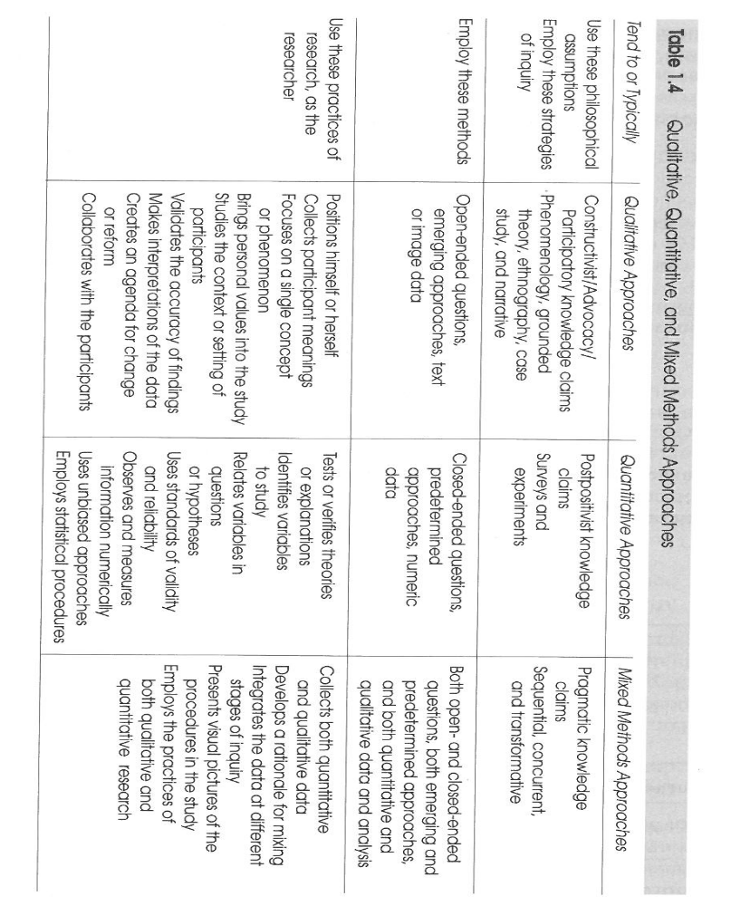

Slide 8
Understanding Behavioral Research
The Research Process:
Tasks that Researchers Would Undertake if they were engaging in
Quantitative, Qualitative or Mixed Methods Inquiry

Slide 9
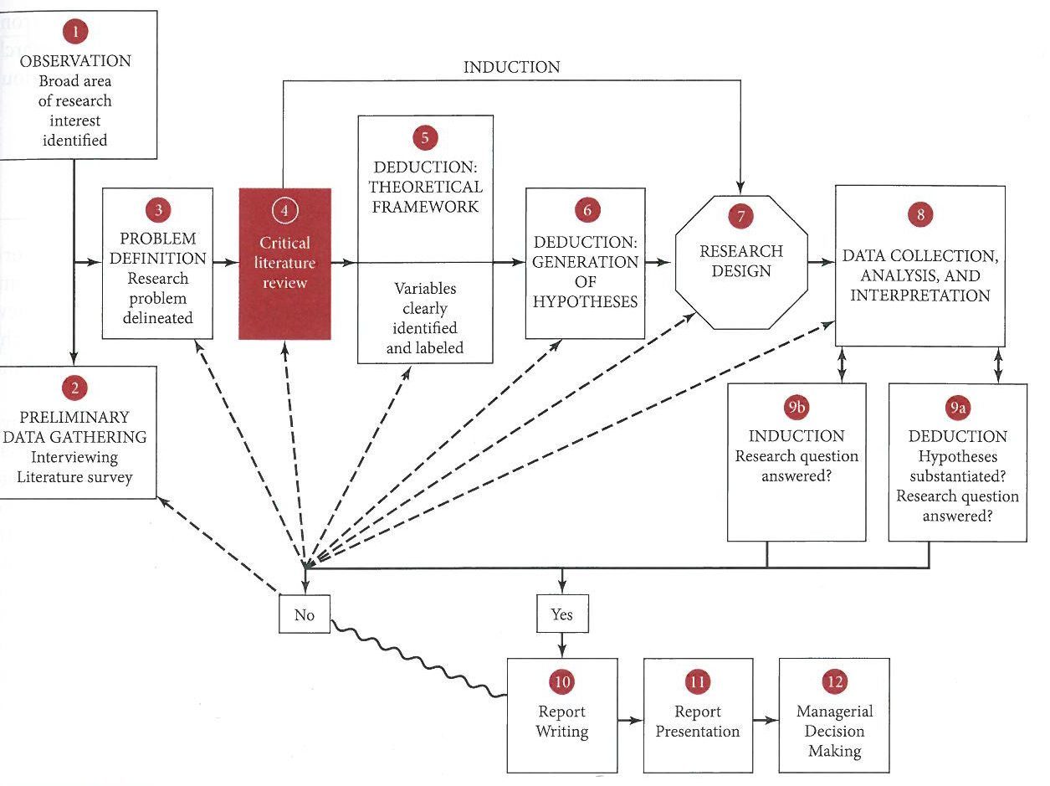

Slide 10
A General Process and Elements of Disciplined Inquiry
(after Creswell, 2013 and Sekharan and Bougie, 2016—adapted by Chatterji)
The Research Process
[Linear OR. Iterative and Emergent Processes OR Combination]
Tools of Inquiry and
Research Design Options
Formulate Questions
Frame the Theoretical Lens, OR a Conceptual
Framework (“Logic Model”) to Guide Study
Collect Data
Analyze Data Validate,
Verify, Identify limitations
Conclusions
Write-up and disseminate
Predominantly Qualitative
OR Predominantly Quantitative
OR
Mixed-Methods Designs
Clarify: Claims and Beliefs about how Knowledge is Created
Clarify: The Researcher’s Role
Conceptualized by researcher based on a literature review, hunches or observations
Translated into a series of research activities

Slide 11
Linking Research Questions with the “right” Study Design(s)
Formulating Questions for Quantitative Designs
Business Research Q:
On average, do different types of ownership (state-owned, publicly –traded, private) lead to variable growth rates of firms in the offshore drilling industry?
“Types of ownership”= Independent variable
“Growth rates”= Dependent Variable
“lead to”: suggests a directional relationship, possible causality
“firms in the offshore drilling industry”= Population and population units
What study designs would be most apt?
Covariation? Correlation? Family of non-experimental designs
Cause and Effect? Family of experimental designs

Slide 12
Research Questions contd.
Another way to ask the question:
What factors influence growth rates that are under different types of ownership (state-owned, publicly –traded, private)?
[More exploratory but still correlational Q --explores covariation between several possible variables and growth rates]
Key criteria for selecting quantitative designs
Directional relationship(s) among variables are of interest
The variables/constructs are usually pre-identified and measurable in numeric terms
Population and population units identifiable: “firms in the offshore drilling industry”
Goal: Study a sample—generalize to population—use statistical hypothesis tests to generalize results; probabilistic decision

Slide 13
Linking Research Questions to the “right” study designs
Formulating Questions for Qualitative Designs
Education Problem:
How easily, and in what ways, are students who recently immigrated to the U.S. assimilating with peers in an urban public school?
Why are some immigrant children having more difficulty assimilating? What barriers do they experience in having a positive schooling experience?
Key criteria for selecting qualitative study designs
Unknown phenomenon or issue: student assimilation with peers in school
Open-ended, “why” or “how” question about issue—may be a process issue or a descriptive issue (“in what ways?”)
Small group focus: “some immigrant students”
Context specific issue: in an “urban school”
Reliance on non-numeric data—observational, interview-based data.
Key constructs are not pre-set--still to be uncovered; not quantitatively measurable variables, although some such data may be collected.

Slide 14
Linking Research Questions To the “Right” Study Designs
APPLICATION EXERCISE
Women’s Studies Problem:
How do women in a psychology doctoral program describe their decision to return to school and their reentry experiences? Which background and school-related factors maximize degree completion rates?
Quantitative, Qualitative or Mixed methods study design?
Explain.

Slide 15
RECAP-What is Research? Types of Research
Conclusion-oriented inquiry (Alkin)—also called Basic or Fundamental Research (Sekharan and Bougie)
Conducted for the purposes for adding to the formal and theoretical knowledge-base in a domain or discipline of study ( e.g., physics, psychology, education, business, health).
Primary Goal: Theory development, theory verification, knowledge-production in an academic field

Slide 16
Homework/Practice
Identify the distinctions between data-based decision-making vs. research?
Formulate research questions that could be best answered with:
  Quantitative designs
  Qualitative designs
  Mixed-methods designs

Slide 17
RECAP-What is Research? Types of Research
Decision-oriented inquiry (Alkin)—also called Applied Research (Sekharan and Bougie)
Conducted for the purposes for solving an applied problem that is of some larger social or practical significance, and to inform decision-making needs of professionals, practitioners, or policy-makers in different fields of study ( e.g., in psychology, education, business, health).
Primary Goal: Inform actions and decisions in organizations or communities (includes “Evaluation Research” in public sector organizations)

Slide 18
RECAP-What are “Research Methods”?
“Research Methods” (see Handout):
Speak to how research is carried out-
Disciplined approaches, tools of inquiry, and research strategies utilized by researchers for gathering and analyzing different kinds of data to investigate, and gain deeper understandings of a research problem.
  Quantitative designs
  Qualitative designs
  Mixed-methods designs

Slide 19
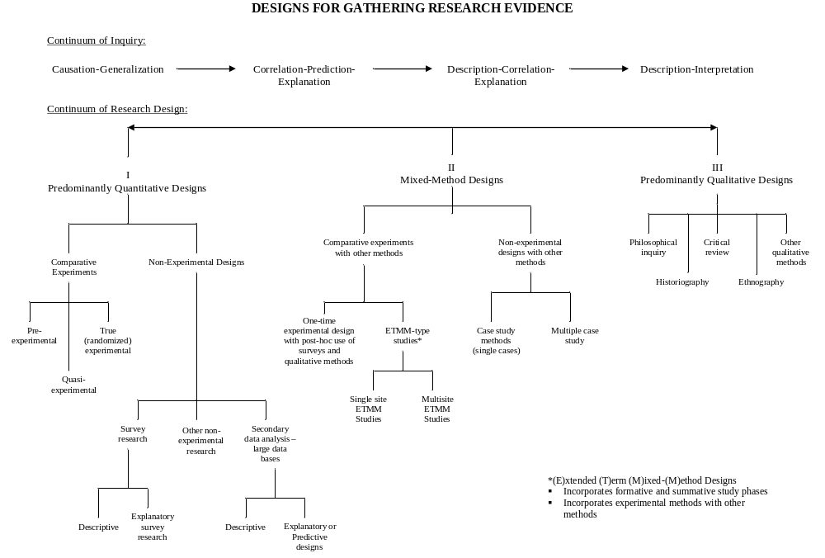

Slide 20
